Slide 1
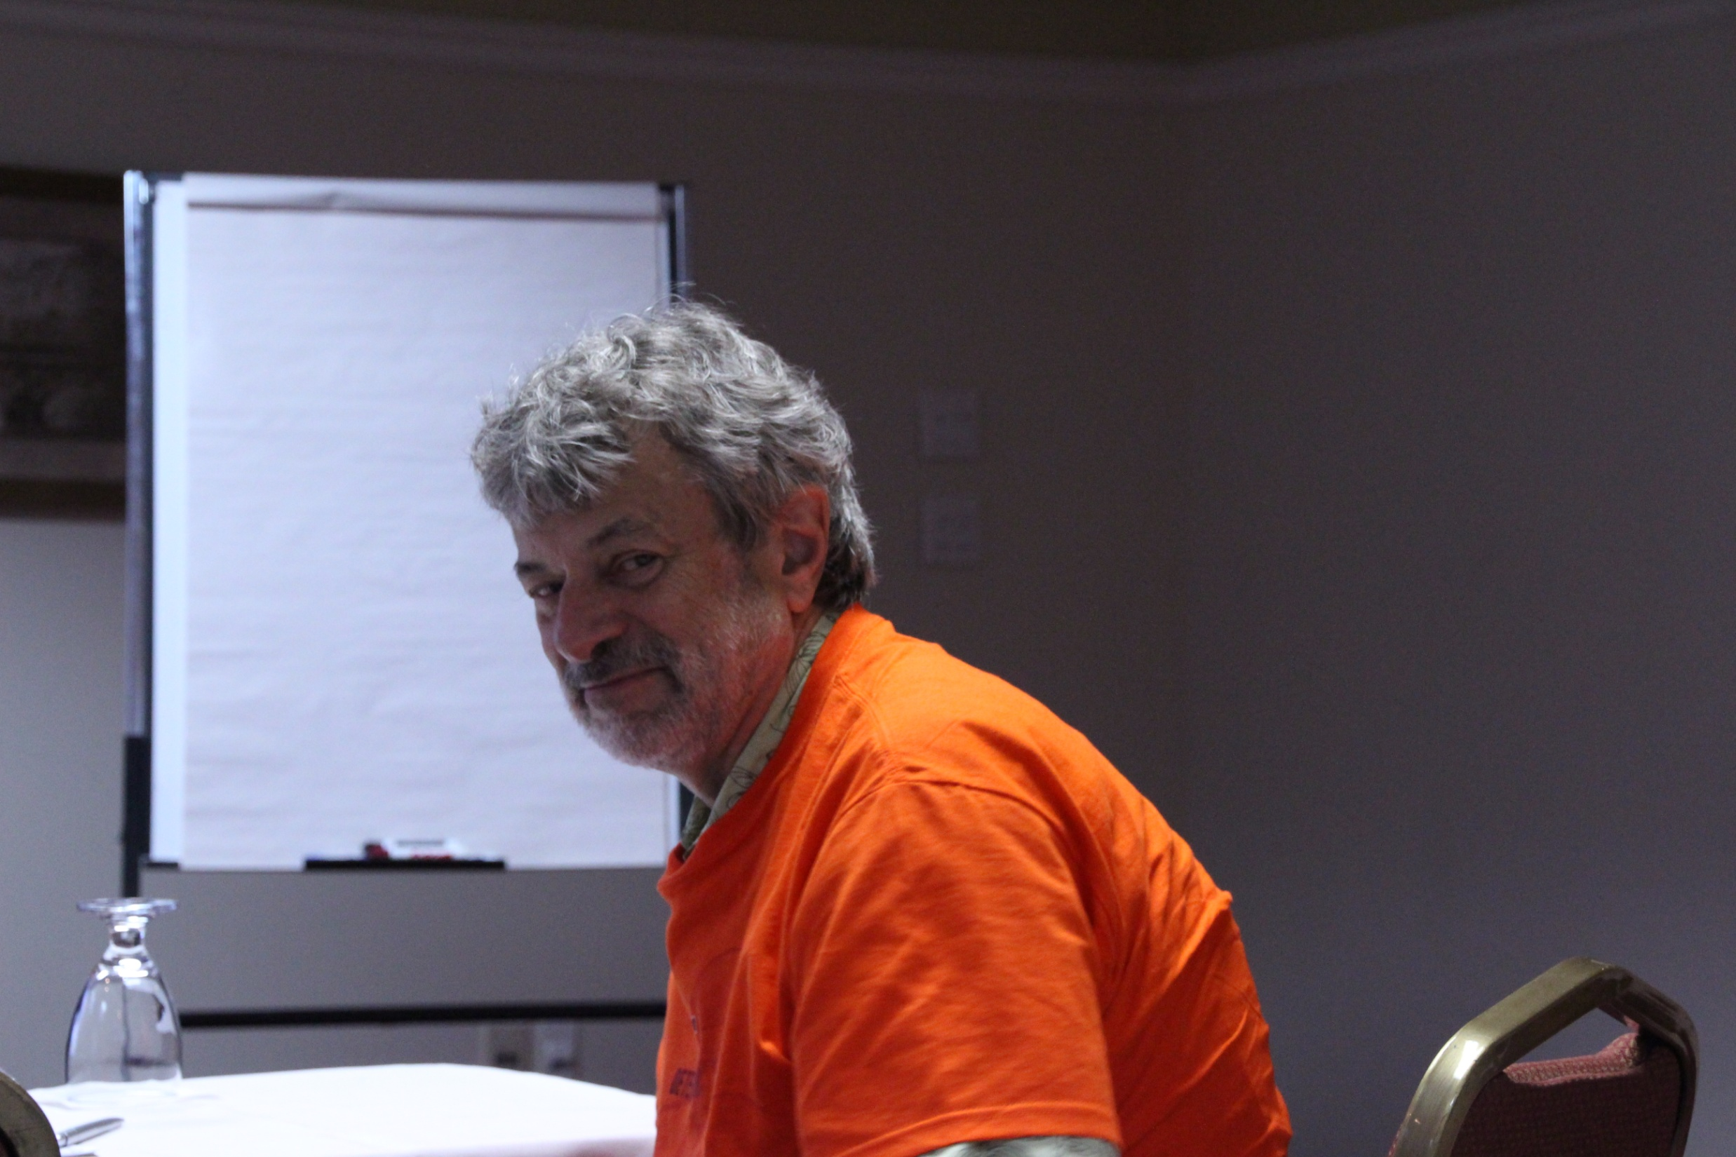
MAGE: Models and Algorithms for Genome Evolution 2013
Ron Zeira
ACGT group meeting
9.10.13
(Happy birthday)

Slide 2
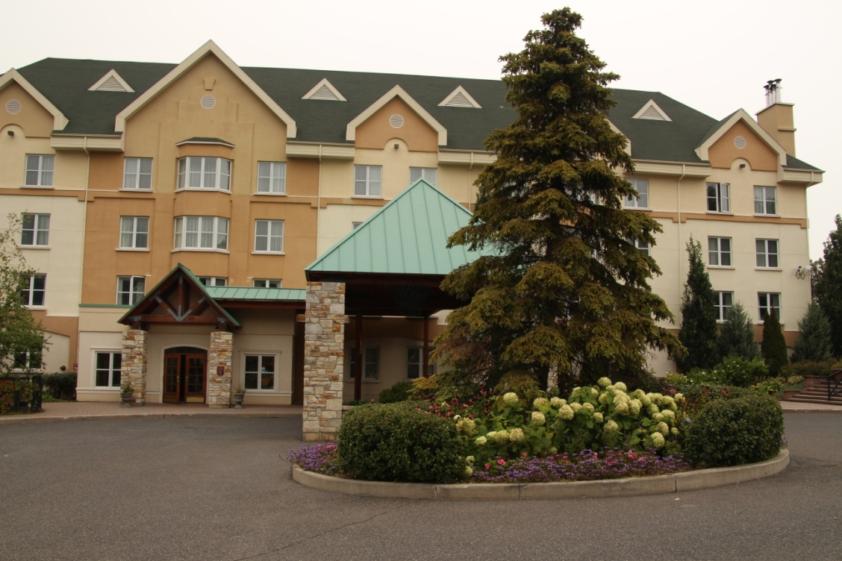
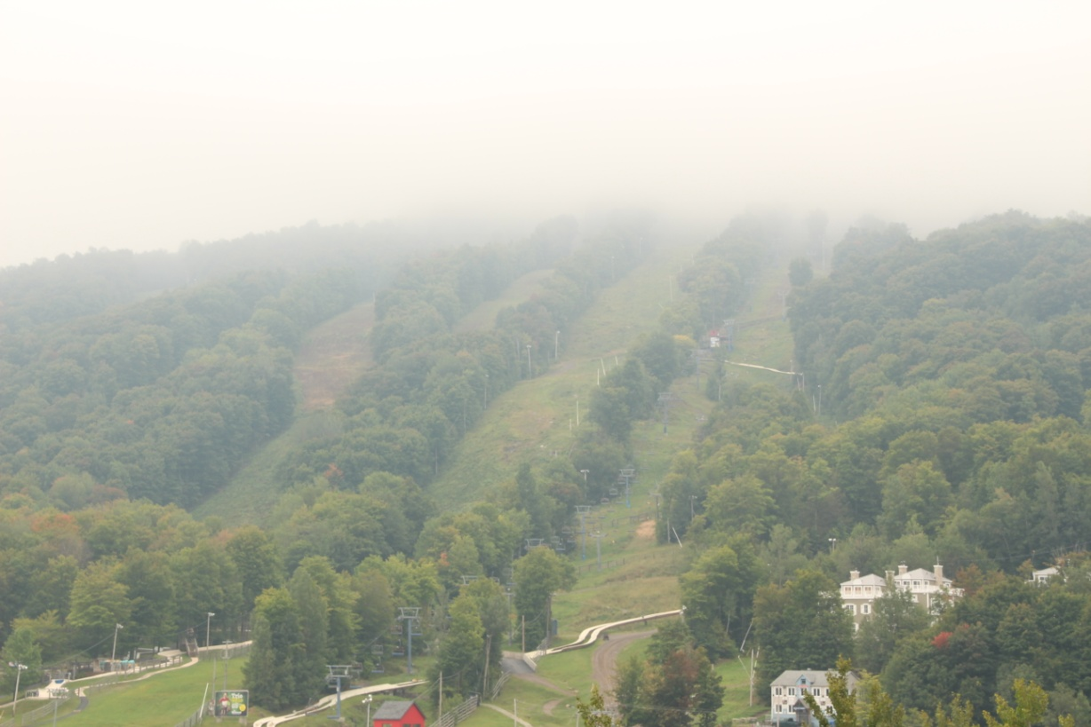
MAGE conference
August 23-26. Bromont, Quebec, Canada.

Slide 3
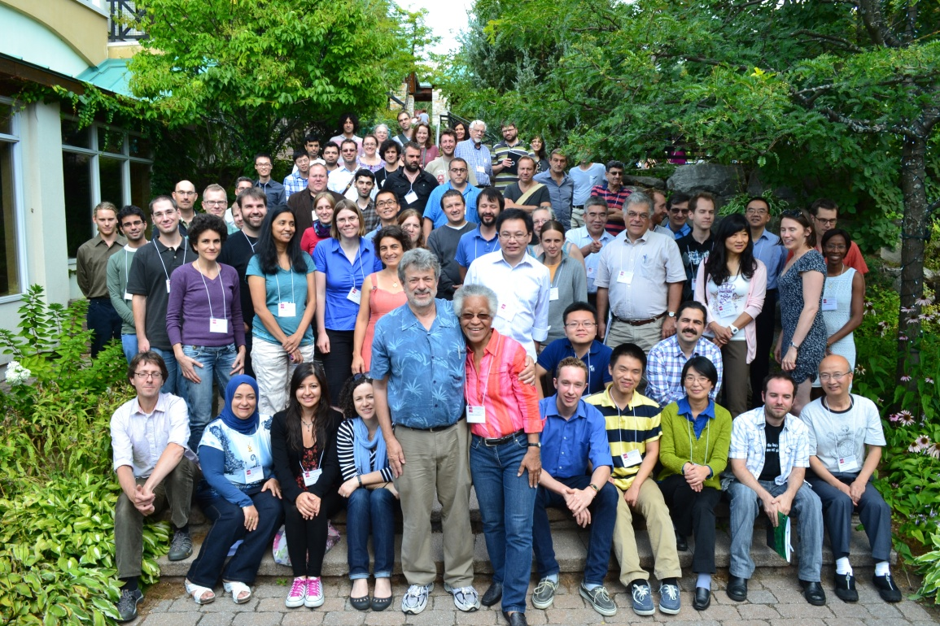
Scientific contex
Celebrate 50 years of scientific contribution of David Sankoff.
Give a retrospective and prospective view on comparative genomics.

Slide 4
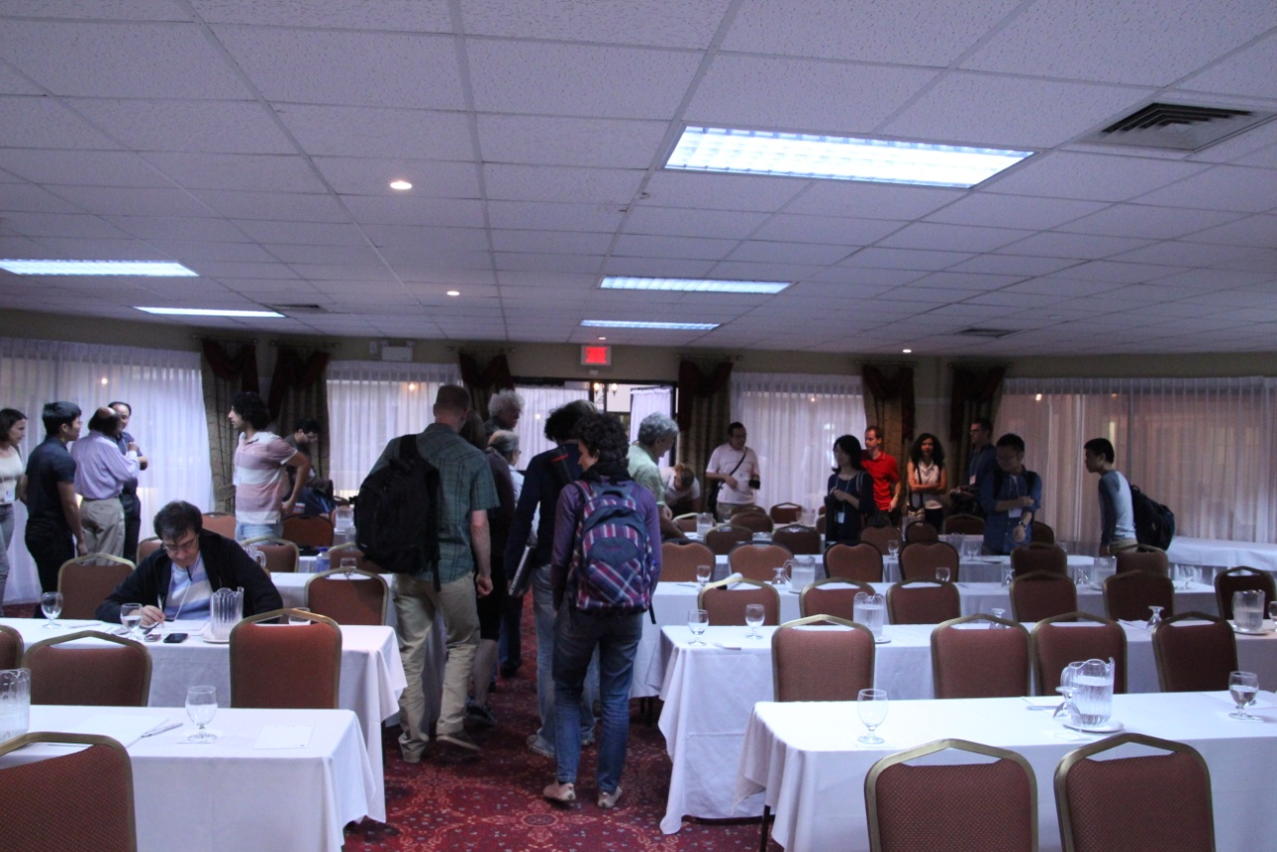
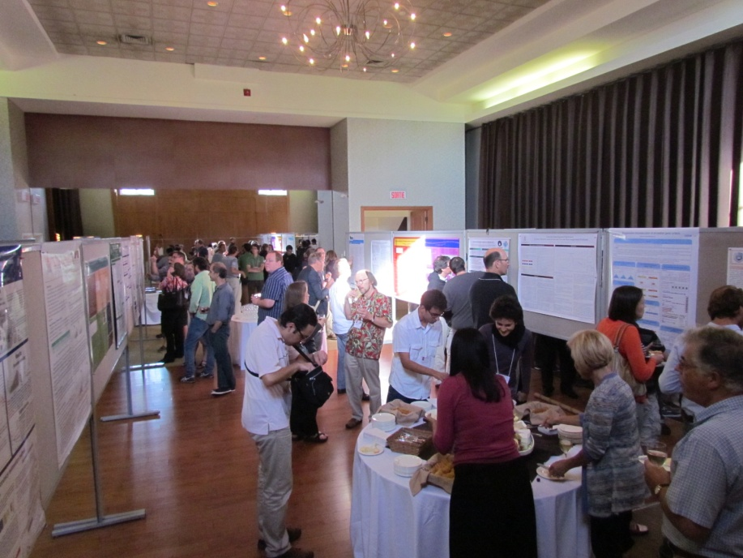
Scientific contex
Boutique conference.
Highly commended computer scientists.
Focus: Evolutionary genomics and genome rearrangement.

Slide 5
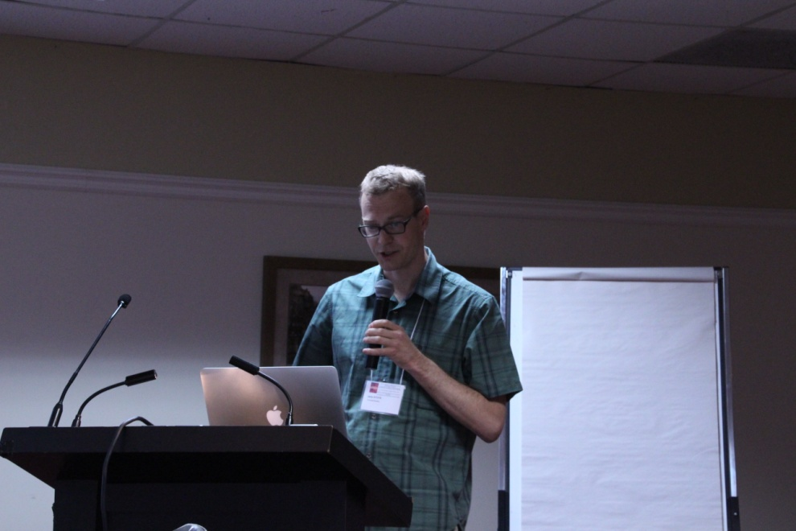
Gene family assignment-free comparative genomics RECOMB CG 2012
Daniel Dörr, Annelyse Thévenin, Jens Stoye
Center for Biotechnology (CeBiTec), Bielefeld University, Germany
Jens Stoye MAGE talk:
http://www-etud.iro.umontreal.ca/~lafonman/MAGE2013/slides/Jens-Stoye-MAGE.pdf

Slide 6
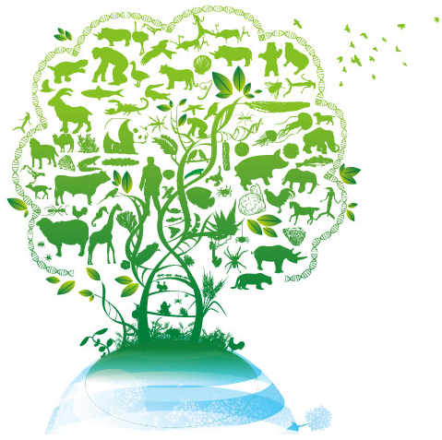
Outline
Introduction and motivation
Model
Solutions
ILP solution
Heuristic
Results
Expansions
Summary & Ideas

Slide 7
Comparative genomics
Two levels of genome evolution:
Small scale mutations: point mutations.
Large scale mutations: rearrangements, duplications, insertions, deletions.
Structural organization provides insights into:
Phylogeny and evolution.
Gene function and interactions.

Slide 8
Genomes
Genomes: Series of oriented genes.
Questions: Genomic distance? Rearrangement Scenario? Phylogeny?
G₁
G₂
G₃
Oriented gene
Adjacency
Notes:
Classic model : single copy genes.

Slide 9
Gene families
Gene pair homology:
Orthology
Paralogy
Xenology
More realistic:
Notes:
Homologous sequences are orthologous if they are inferred to be descended from the same ancestral sequence separated by a speciation event
Homologous sequences are paralogous if they were created by a duplication event within the genome
Homologs resulting from horizontal gene transfer between two organisms are termed xenologs

Slide 10
Gene clusters
Based on sequence similarity.
DBs: COG, eggNOG, Inparanoid …
More data on more species.
Parameter dependant.
No evolutionary relationship.
Usually uncurated.

Slide 11
Gene family trees
DBs: TreeFam, OrthologID …
Considers evolutionary relationships.
Species tree accounted.
Manually curated.
Usually sparse.
Less species.

Slide 12
Gene order studies
Breakpoint distance
# unconserved adjacencies
No explicit operations
Approximate common interval
Gene cluster defined as a set of maximal intervals, that share the same genes.
Small differences allowed.
double-cut-and-join (DCJ)
Simulate most rearrangements
Gives a sorting scenario

Slide 13
Motivation
Study gene order without prior gene family assignment.
Use genes similarity values to resolve gene order.
Minimize conserved breakpoints.

Slide 14
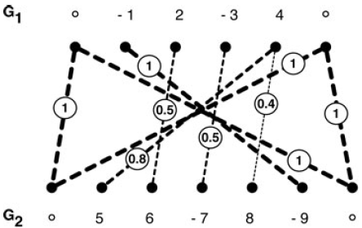
Model
Set of genes
Linear Chromosome – signed gene sequence flanked by telomers
Normalized similarity measure
Ordered weighted bipartite graph
Positive wedges only
Telomeres weight 1

Slide 15
Matchings
Matching – set of disjoint edges in B
edg(M) – weighted sum of edges in M.
Saturated gene – incident to an edge in M.
Consecutive genes – no saturated edge between them (in the same genome).
Conserved adjacency – 2 consecutive gene pairs (from each genome) s.t. the paired orientation is the same or reversed.

Slide 16
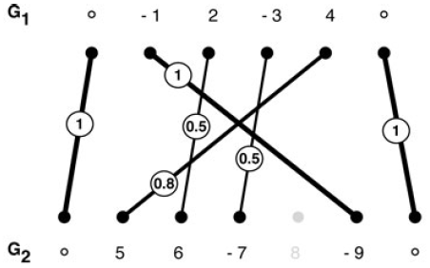
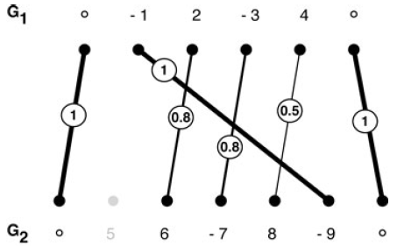
Matchings
adj(M) – weighted sum of conserved adjacencies in M.
M1 – max(edg(M))
M2 – max(adj(M))

Slide 17
Problem definition
Conserved adjacencies scoring:
let:

Slide 18
Hardness
Simplifying assumptions:
Families are given.
Edge weights 1.
Components are cliques.
Maximizing #adj in NP-hard (Angibaud et al.).
Finding a maximum matching maximizing adjacencies in NP-hard (Tang and Moret).

Slide 19
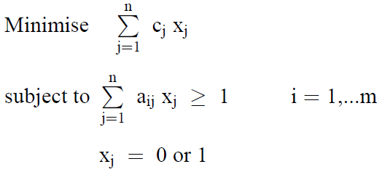
ILP example - Set cover
http://www.doc.ic.ac.uk/~br/berc/integerprog.pdf

Slide 20
ILP exact solution
a(i,k) is 1 iff e_{ik} in M.
b_{x}(i) is 1 iff the i^{th} gene of genome x is saturated.
c_{x}(i,j) is 1 iff the i^{th} and j^{th} genes of genome x form a consecutive pair.
d(i,j,k,l) is 1 iff the i^{th} and j^{th} genes of the first genome and the k^{th} and l^{th} genes of the second genome form a conserved adjacency.

Slide 21
Max
Saturated genes have an edge in the matching
Each connected component has an edge in the matching
If a pair of genes have no saturated genes between them then they are consecutive

Slide 22
Consecutive gene pairs have no saturated genes between them
If i,j,k,l form a conserved adjacency then the edges are in the matching and the pairs are consecutive
If i,j,k,l do not have the proper edges or orientation they do not form a conserved adjacency
Notes:
O((n1n2)^2) constraints

Slide 23
Heuristic
ILP can’t solve all cases.
Based on IILCS (Angibaud et al.).
IILCS solves α=1, unweighted clique families.
LCS = Longest Common Substring:
2 genomes G₁, G₂: find longest substring S.
Up to complete reversal.
ABABC
|||
BABCA
|||
ABCBA

Slide 24
Modified heuristic
Find common substring max target function.
Remove unsaturated genes with no unsaturated neighbors.
Attempt to increase common substring.
Stop criterion: no neighboring unsaturated genes.

Slide 25
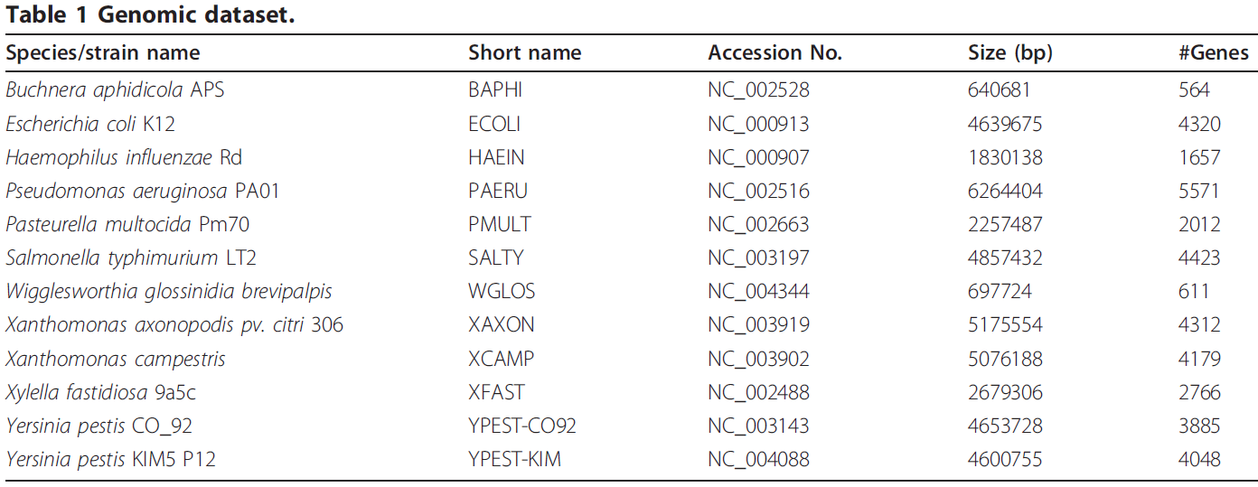
Data
12 γ-proteobacteria from Lerat et al.

Slide 26
Exact algorithm vs. heuristic
Only 40 genome pairs had ILP solution for all α

Slide 27
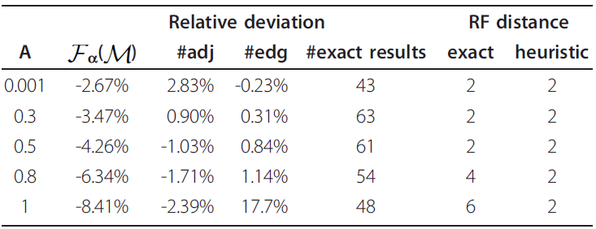
Exact algorithm vs. heuristic
Relative deviation
Notes:
For the majority of all cases
we were able to reconstruct the tree correctly up to a
single internal edge, causing an RF distance of 2 to the
original tree.

Slide 28
Evaluating phylogenies
Compare phylogenetic trees for different distances.
Normalized number of breakpoint distance:
Neighbor joining for tree construction.
Reference tree by Lerat et al.
Robinson Foulds topological distance (RF distance).

Slide 29
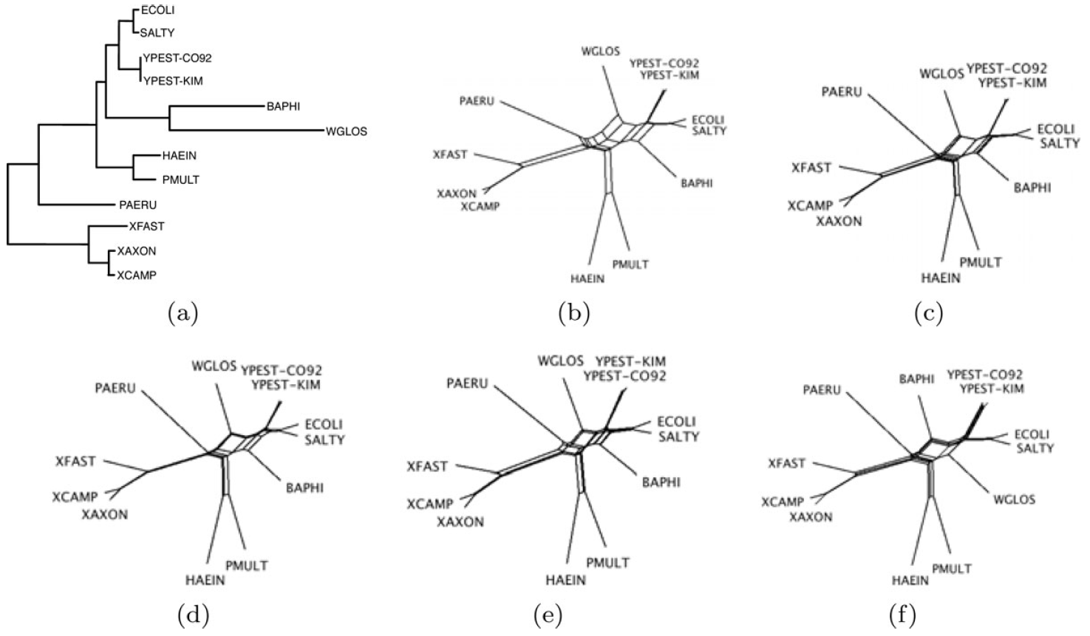
NeighborNet view
Reference
Previous method
α=0.001
α=0.5
α=0.8
α=1
Notes:
This internal edge connects the two organisms
Buchnera aphidicola (BAPHI) and Salmonella
typhimurium (SALTY) with the rest of the tree (Figure
4(a)). This branch is known to be particularly hard to
reconstruct since the two organisms diverged far from
each other, resulting in two long external edges in the
tree.

Slide 30
Extensions

Slide 31
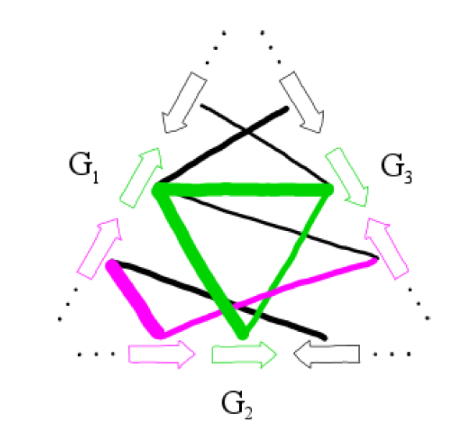
Expand to more genomes

Slide 32
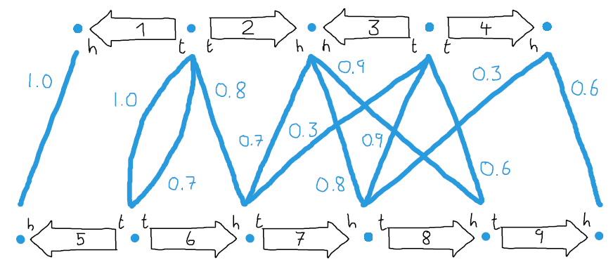
DCJ with similarities
Weighted adjacency graph (WAG):

Slide 33
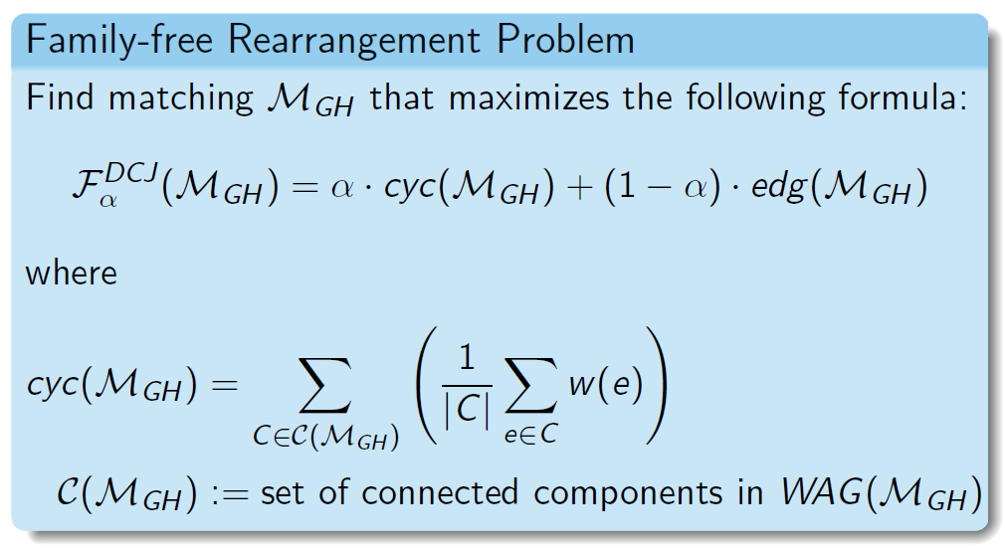
DCJ with similarities

Slide 34
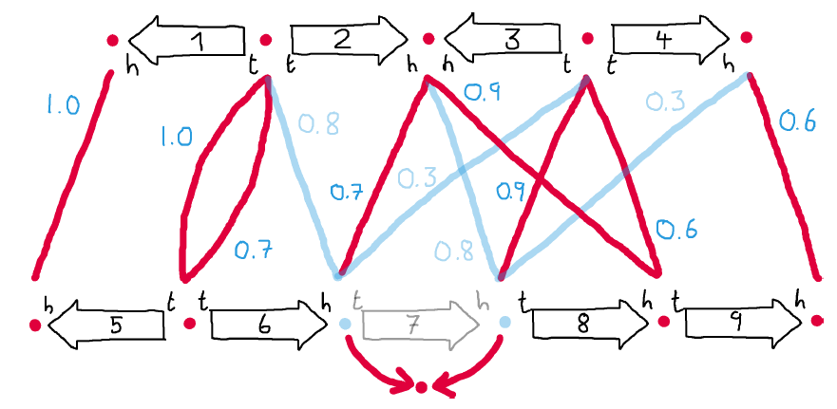
DCJ with similarities

Slide 35
Summary
Novel approach – genome comparison with gene similarities.
More realistic model.
ILP solution for small genomes.
Good heuristic.
Can be extended to other models.

Slide 36
Food for thought
Maximum matching based algs?
LP relaxation?
Approx specific α?
Max common substring matching?
Different objective?
DCJ models?
Define new problems?

